Slide 1
Progress Report
Yoonsang Lee,
Movement Research Lab.,
Seoul National University

Slide 2
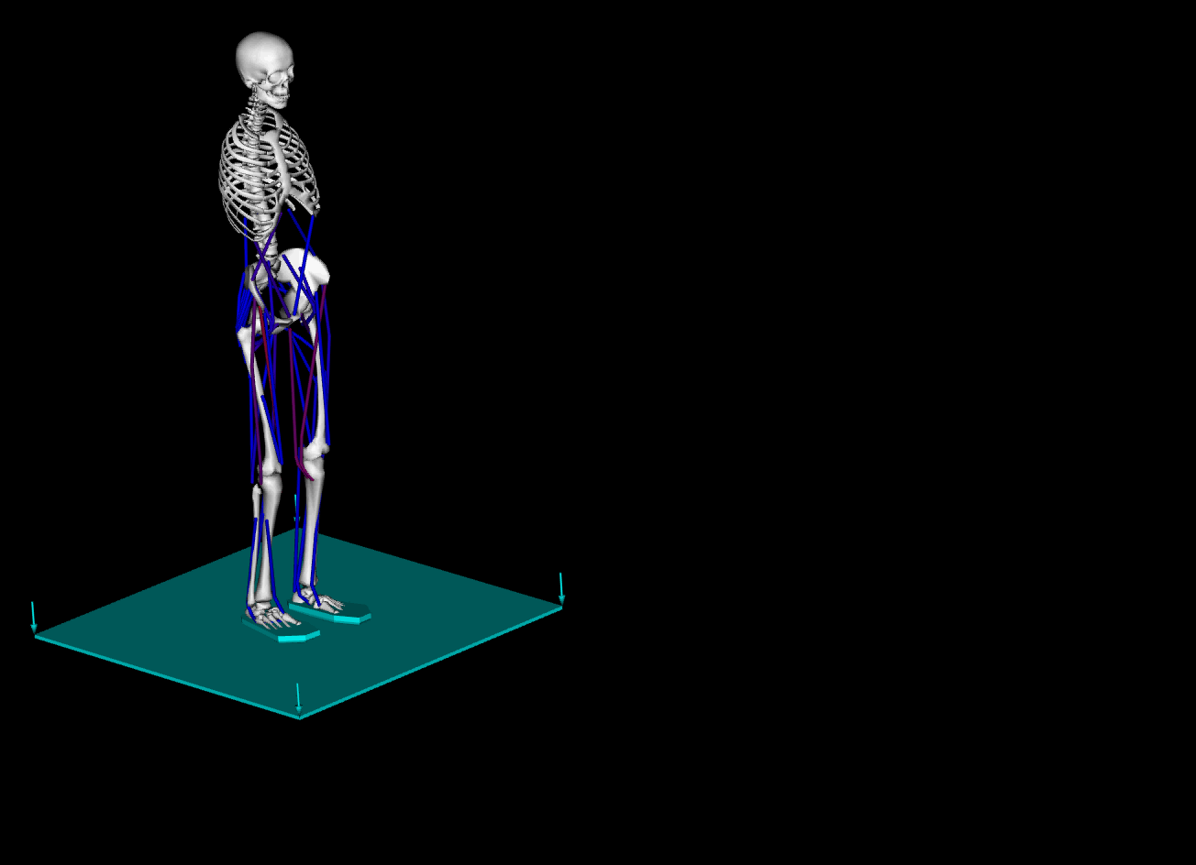
Previous Result

Slide 3
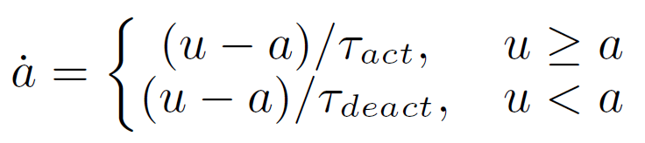
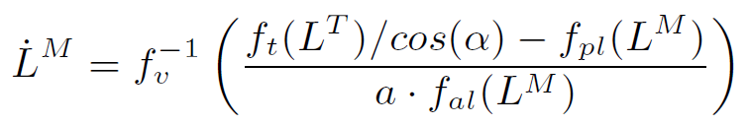
Dynamics of Musculoskeletal System
Activation dynamics
Contraction dynamics
Forward dynamics (equations of motion)

Slide 4
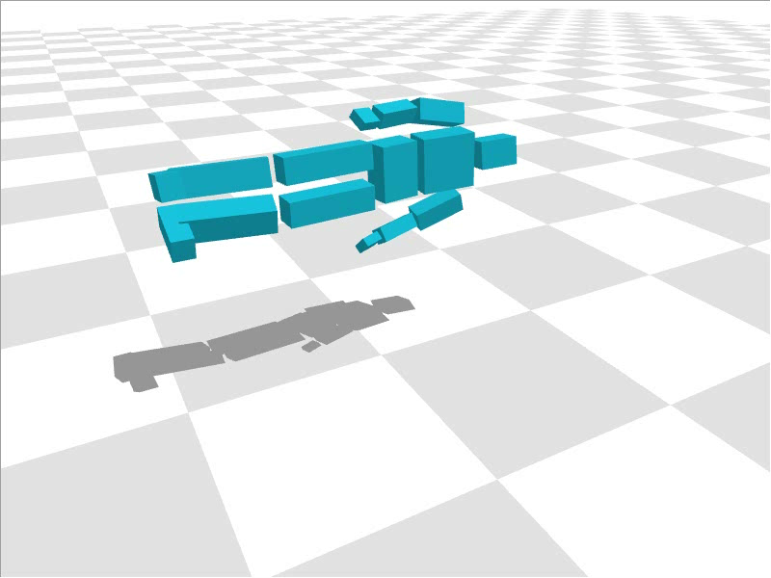
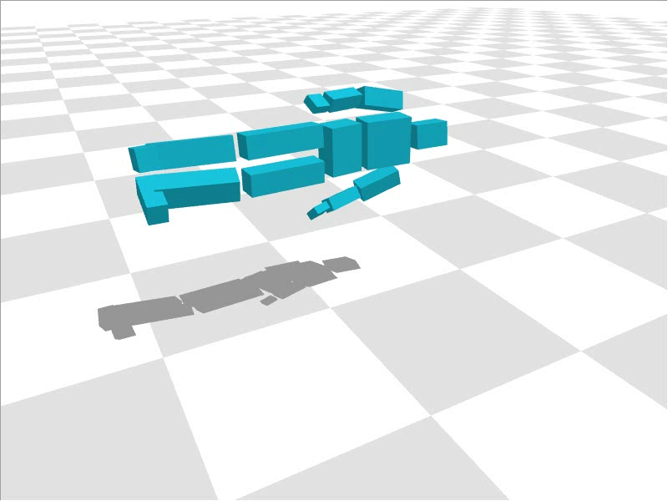
Inverse / Hybrid Dynamics
OpenSim : inverse dynamics(not good), hybrid dynamics(x)
Use those of VirtualPhysics
Inverse dynamics tracking
Hybrid dynamics tracking

Slide 5
Model Converting
Forward dynamics : OpenSim
Inverse / hybrid dynamics : VirtualPhysics
OpenSim model -> VirtualPhysics model
  Rigidbody (mass, inertia, CoM)
  Joint (position, axis)
  No muscles

Slide 6
Tracking Control
(prev) Muscle state based PD control
  Muscle state -> muscle excitation

Slide 7

Tracking Control
Inverse / hybrid dynamics tracking control
  Biped state -> desired acceleration
  :
  Accelerations -> torques
  : Inverse / hybrid dynamics solver
  forces :
  excitations(?)

Slide 8



Tracking Control Test
Actuator Type
  Torquer (motor)
  Path forcer (ideal muscle)
Control Type
  Inverse dynamics
  Hybrid dynamics
  Joint PD
Force distribution
  Minmum norm :
  Quadratic Programming :

Slide 9
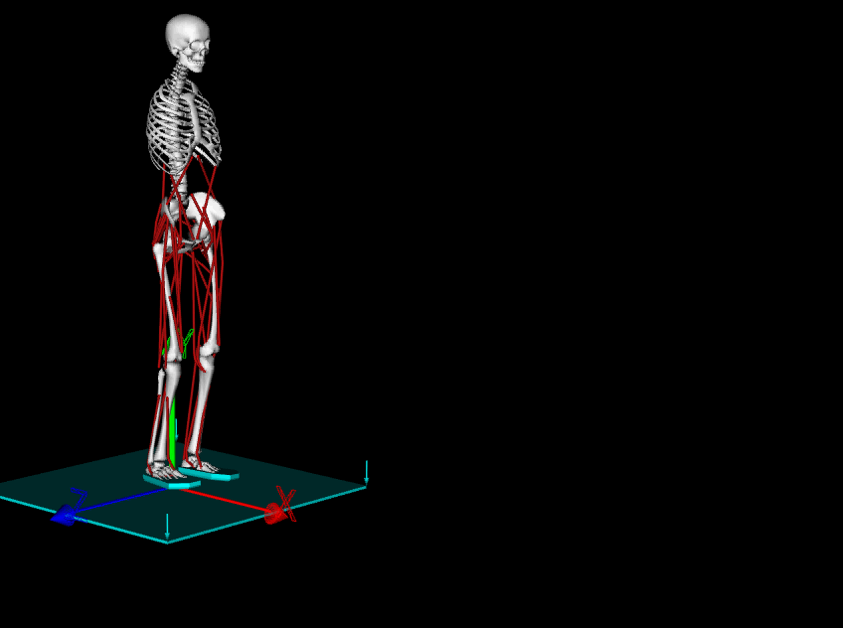
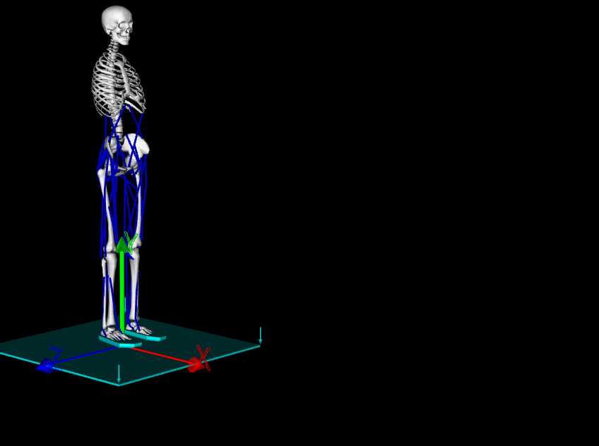
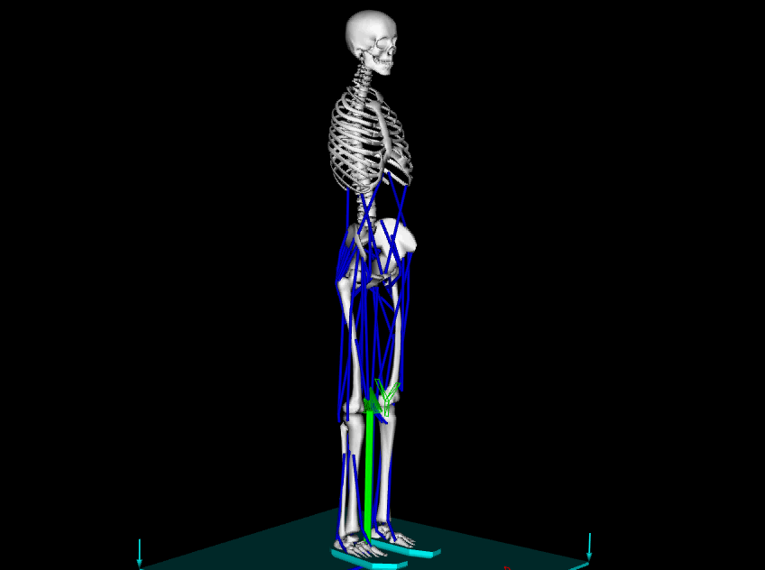

reference motion (1.0x slower)
torquer, inverse dyn (4.8)
torquer, hybrid dyn (4.8)
torquer, PD (5.3)

Slide 10
torquer, hybrid dyn
(4.8)
path forcer, hybrid dyn, min norm
(10.4)

Slide 11
path forcer, PD, min norm
(10.8)
path forcer, PD, QP
(24.9)

Slide 12
Thank you

