Slide 1
Predicting outcomes of rectus femoris transfer surgery

Slide 2
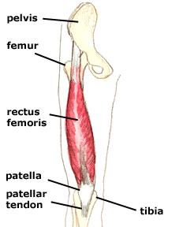
Rectus Femoris Transfer
Common treatment for stiff knee gait
Unfortunately, the improvement in knee motion after surgery is inconsistent.

Slide 3
Goal
Select a set of preoperative gait features that distinguished between good (i.e., no longer stiff) and poor (i.e., remaining stiff) postoperative outcomes
Determine which combinations of preoperative features best predicted postoperative outcomes

Slide 4
Methods
Training data : preoperative gait data of subjects categorized as “good” or “poor” outcome
Features distinguishing between good & poor group
  literature-based, filter-based
Determine combinations of features that best predict outcome
  by Linear Discriminant Analysis (LDA)

Slide 5
Subjects
Obtain gait analysis data of each subject before and after the RTF
  joint angles, moments, powers during gait cycle
From postoperative data,
  “good outcome” - 31 subjects
  “poor outcome” - 31 subjects

Slide 6
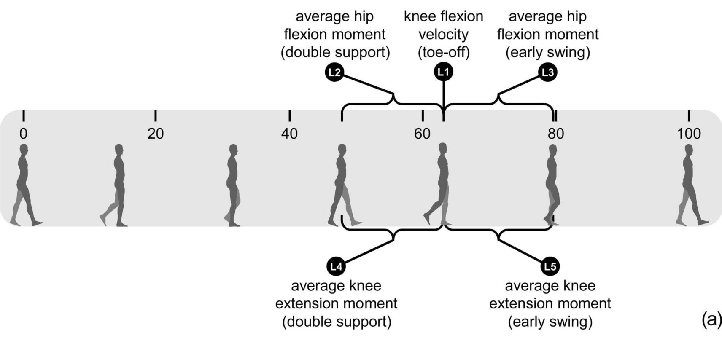
Literature-based features

Slide 7
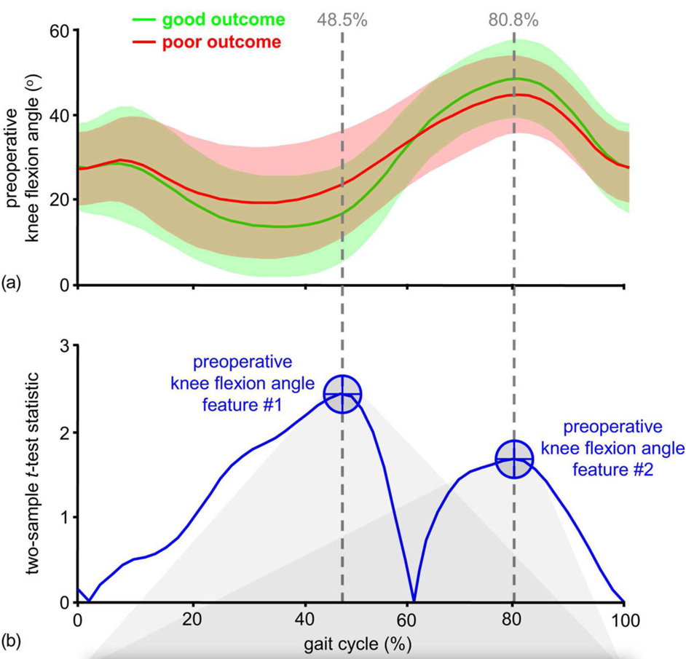
Filter-based features

Slide 8
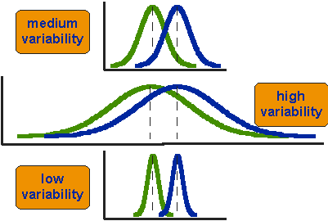
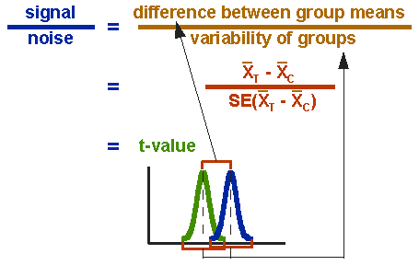

Two-sample T-test
assesses whether the means of two groups are statistically different from each other.

Slide 9
Filter-based features
m x n unfiltered features
  m measures of gait data
  n number of sample
-> Filtered to 25 features with highest t-test scores
  based on the discriminant power of the gait analysis data

Slide 10
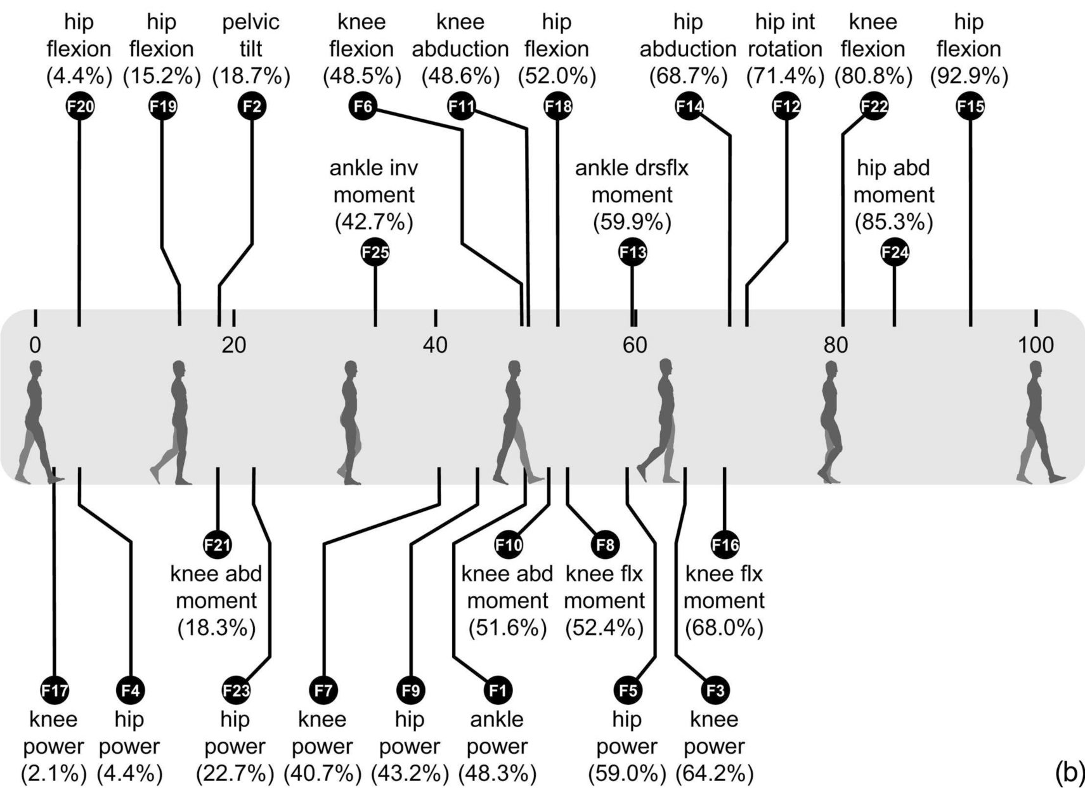
Filter-based features

Slide 11
Combinations of Features
We have 30 features
  5 literature-based, 25 filtering-based
Linear combination of features can predict outcome
  y = w1*f1 + w2*f2 + … + wn*fk
  Linear Discriminant Analysis (LDA)

Slide 12
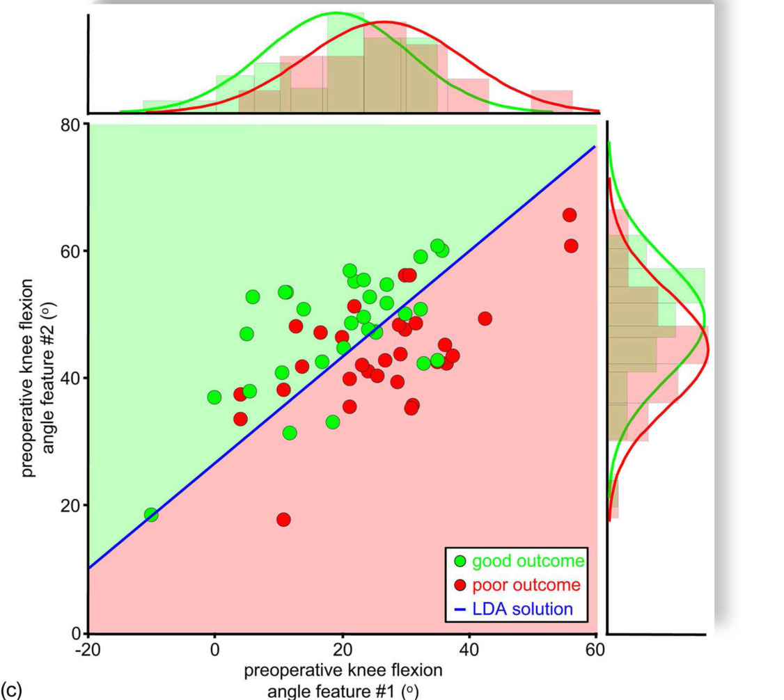
Linear Discriminant Analysis (LDA)
Compute coefficients for linear combination of a given feature set that define discriminant hyperplane.

Slide 13
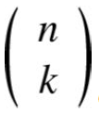
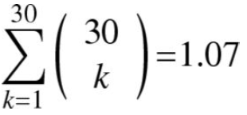
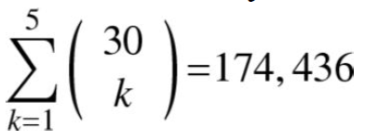
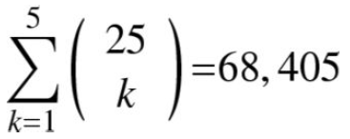
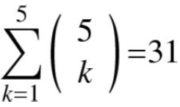
Select Feature Subset
Which features do we use? (f1 … fk)
- # of different k-feature subsets that can be chosen from an n-feature set
Best subset among combinations
billion – too many
subset size limited to 5

Slide 14
LDA training by repeated hold-out method
Randomly choose
  Training set - 80% of subjects
  Testing set - 20% of subjects
Repeated until the mean percentage of correct predictions for all iterations converged to a constant value

Slide 15
Results
Highest (87.9% correct) using a combination of
  hip flexion and hip power after initial contact (4.4% gait)
  knee power at peak knee extension in stance (40.7% gait)
  knee flexion velocity at toe-off (62.7 ± 3.5 % gait)
  hip internal rotation in early swing (71.4% gait)
Remained high (80.2% correct) using a subset combination of only 3 of these features,
  knee flexion velocity at toe-off, knee power, and hip power

Slide 16
Results
Given only 3 filter-based features 78.3% correct
  pelvic tilt at the beginning of single limb support (18.7% gait),
  hip flexion after the beginning of double support (52.0% gait),
  peak knee flexion (79.7 ± 5.1 % gait)

Slide 17
Results
Given only 2 literature-based features 68.1% correct
Given only 1 literature-based feature 67.8% correct
Given only 1 filter-based feature 68.2% correct

