Slide 1
Validity and Reliability of head posture measurement by Microsoft Kinect

Slide 2
Motivation
Accurate measurement of the angle of anomalous head posture is critical.
Why ?
- It is helpful to determine surgical plans of patients with ocular torticollis.

Slide 3
Previous work
Hald ES, Hertle RW, Yang D. Development and validation of a digital head posture measuring system (American journal of ophthalmology 2009)
Kim J, Nam KW, Jang IG, Yang HK, Kim KG, Hwang JM. Nintendo Wii remote controllers for head posture measurement: accuracy, validity, and reliability of the infrared optical head tracker (Investigative ophthalmology & visual science 2012).

Slide 4
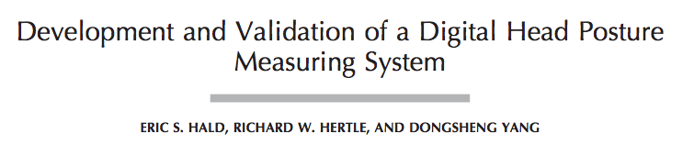
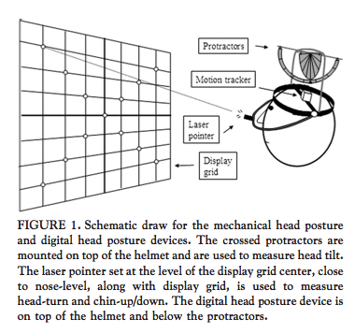
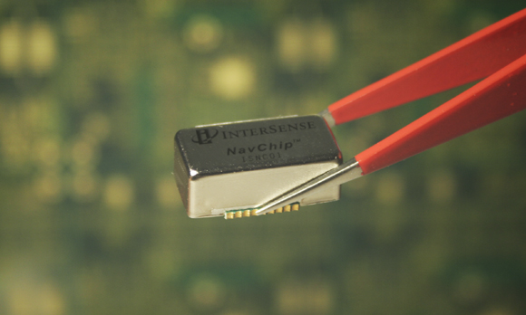
Mechanical head posture & Intersense NavChip

Slide 5
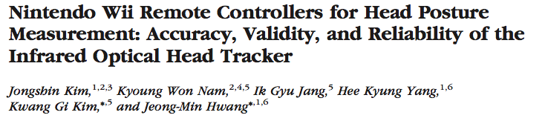
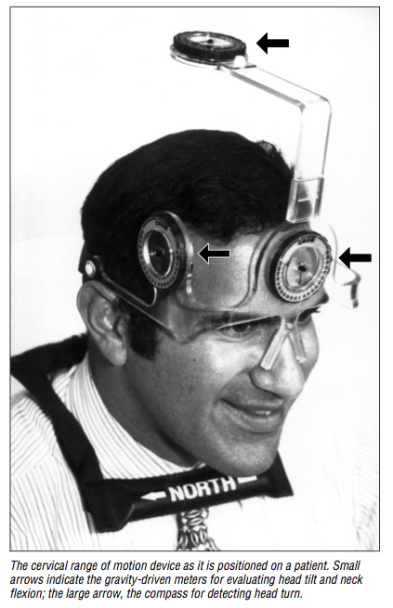
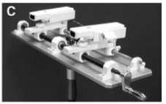
CROM vs. Wii-mote Controller

Slide 6
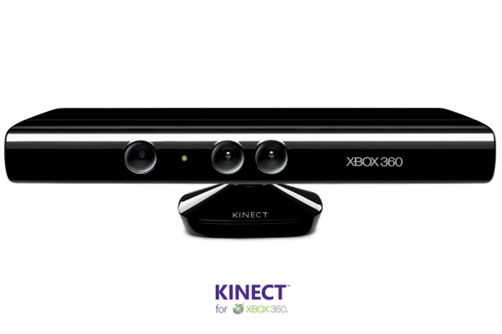
CROM vs. Kinect
Our work

Slide 7
Advantages of our system
High performance
  Validity & reliability
Contact-free
Low-cost

Slide 8
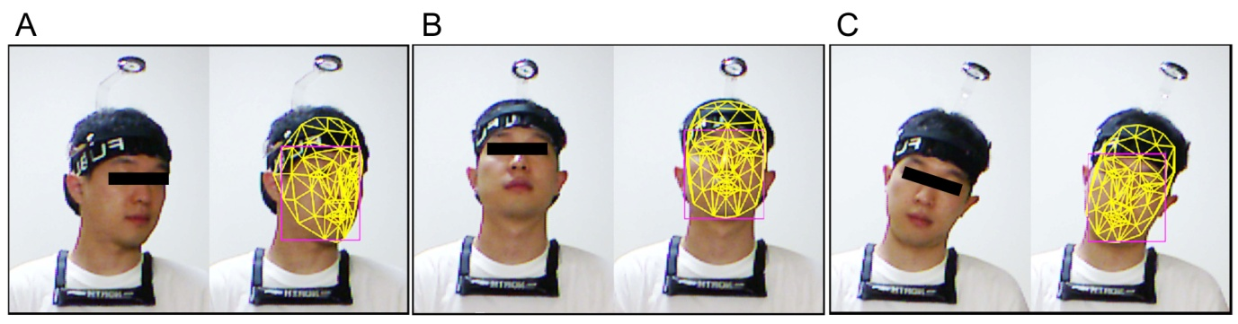
Purpose
Evaluating the validity and reliability of Kinect head tracker (KHT).

Slide 9
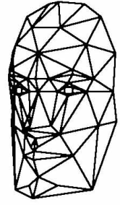
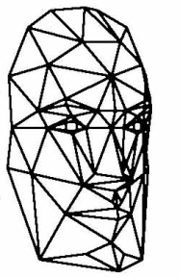
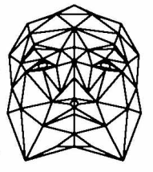
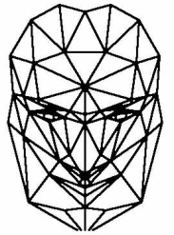
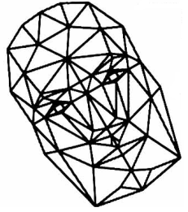
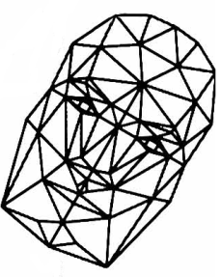
Procedures of Head Pose Rotation
Head turn right/left
Chin up/down
Head tilt right/left
Notes:
3 가지 회전 값이 같은 비율로 증가. 5,5,5 10,10,10 15,15,15 …

Slide 10
Neutral head position (NHP)

Slide 11
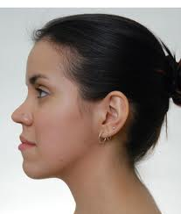
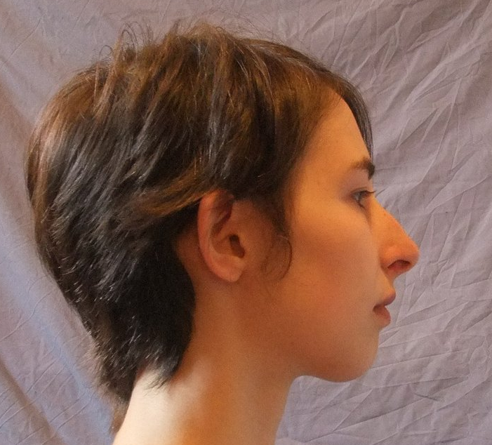
What is the neutral head position?
Head turn : symmetry!
Head tilt : symmetry!
Chin up/down : ? : Various bony morphology

Slide 12
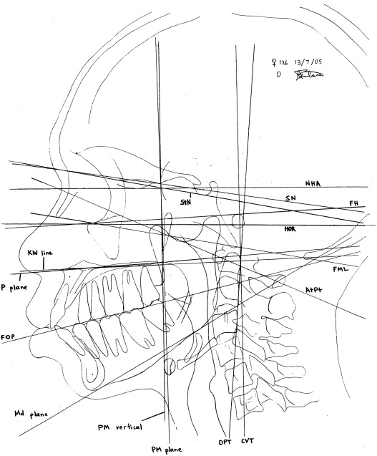
Natural head position (NHP)
  Orthodontics in the 1950s
  A position naturally assumed by a relaxed subject in ortho-position with his/her eyes fixed towards the horizon and without any external interference.

Slide 13
Natural head position (NHP)
  Although it has been under discussion for so long, a single definition of NHP still does not exist.
    CROM – device fitting? Kinect (Candide-3 Model) – zero?

Slide 14
Natural head position (NHP)

Slide 15
Q : 측정한 두위가 정상인가? 비정상인가?
  NHP를 잘 정의하는 것이 중요함.
Q : KHT을 이용한 측정치가 CROM을 이용한 측정치와 잘 일치하는가?
  NHP를 잘 정의하는 것이 중요하지 않을 수 있음.
  Zero position으로 정의한 상태로부터의 변화량이 서로 잘 일치하지 확인하는 것이 더 중요함.

Slide 17
그래서 현실적인 대안으로..
  A trained ophthalmologist manually rotated the subject’s head to an unbiased and straight head-posture by visual estimation, which was double-checked by CROM as the zero position.
  By clicking a button on the keyboard of the personal computer, the zero position was designated as a reference posture that represented all zero angles. Then, the angle rotations that represent the head posture were calculated on the basis of this reference position and the real-time position information .

Slide 18
System setup
일정한 키넥트와 피험자의 상대적인 거리와 높이
  이번 연구에서 : 1m, Subject’s nose
일정한 키넥트 카메라의 방향 : 중력에서 대해서 앞뒤, 옆으로 수평여부
  이번 연구에서 control 하지 못함 : 수평계…

Slide 19
앞서 이야기한대로 zero position과의 차이를 구한 것이라면 키넥트 카메라가 약간 기울어져도 결과해석에 큰 문제는 없지 않을까 생각합니다.
  사실, 키넥트 카메라의 방향이 크게 달라짐에 따라서 head posture 측정에 대한 metric이 달라지면서 결과값에 영향을 줄 가능성은 있지만,
  실제 실험시 zero position을 잡을 때, 그렇게 아주 큰 variation이 있지는 않았기 때문에 (<5도) 이번 연구에서 카메라의 수평여부를 control하지 못한 것은 결과해석에 아주 큰 영향을 줄 것 같지는 않습니다.

Slide 20
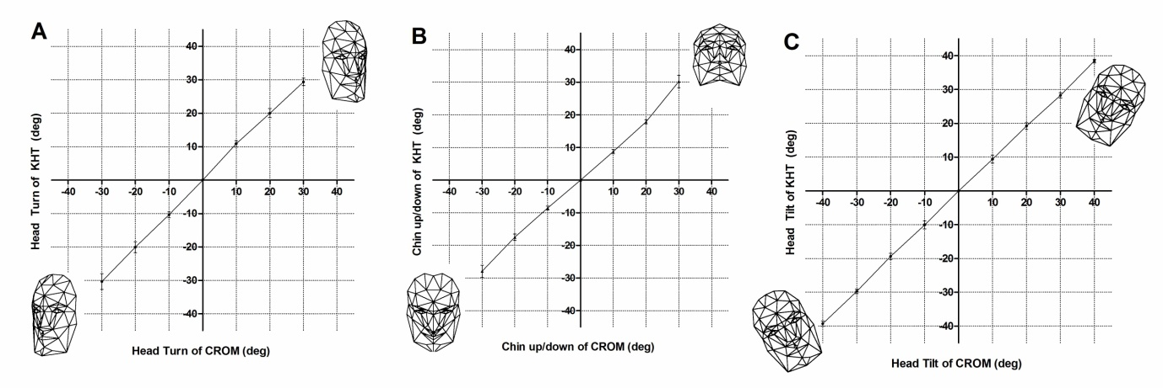
1-D : Validity
Graph
Correlation
Agreement
r=0.998, P<0.001
ICC=0.999
r=0.997, P<0.001
ICC=0.997
r=0.999, P<0.001
ICC=0.999

Slide 21
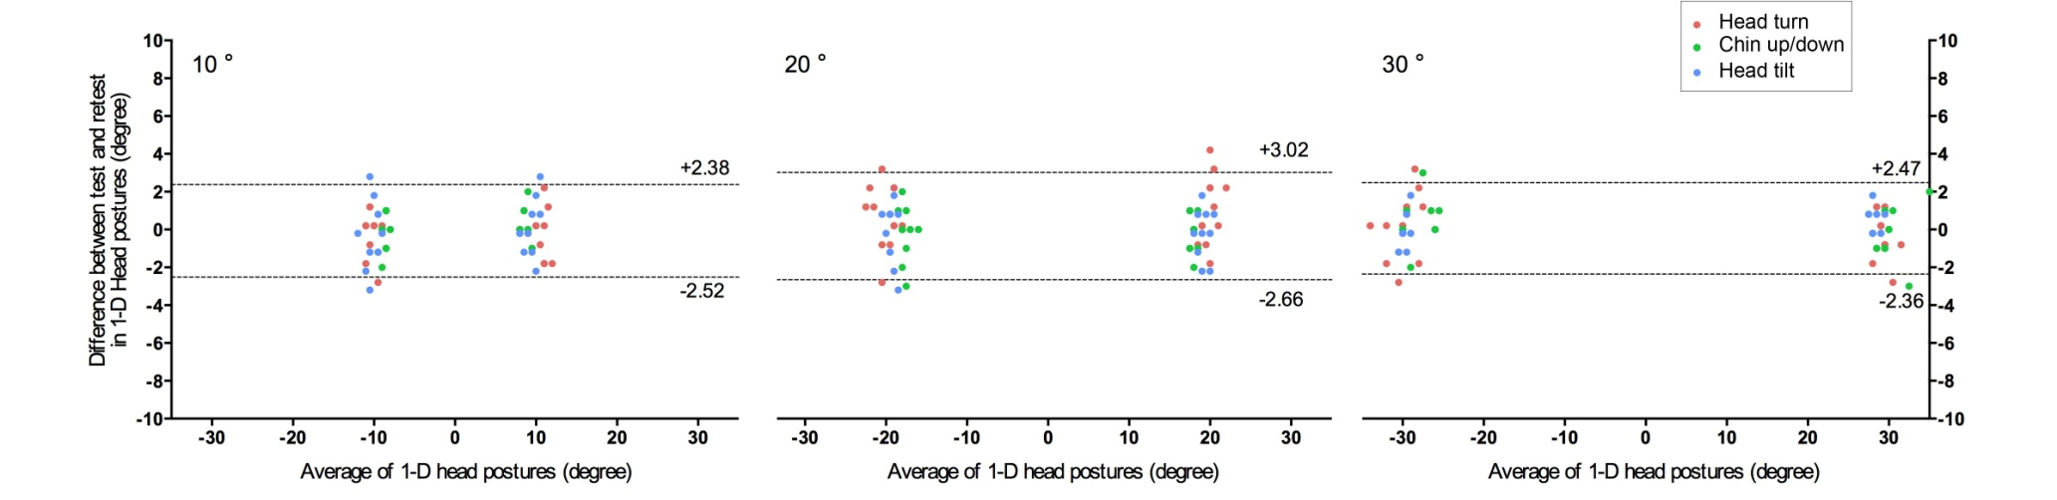
1-D : Reliability (test-retest)
Bland-Altman plot

Slide 22
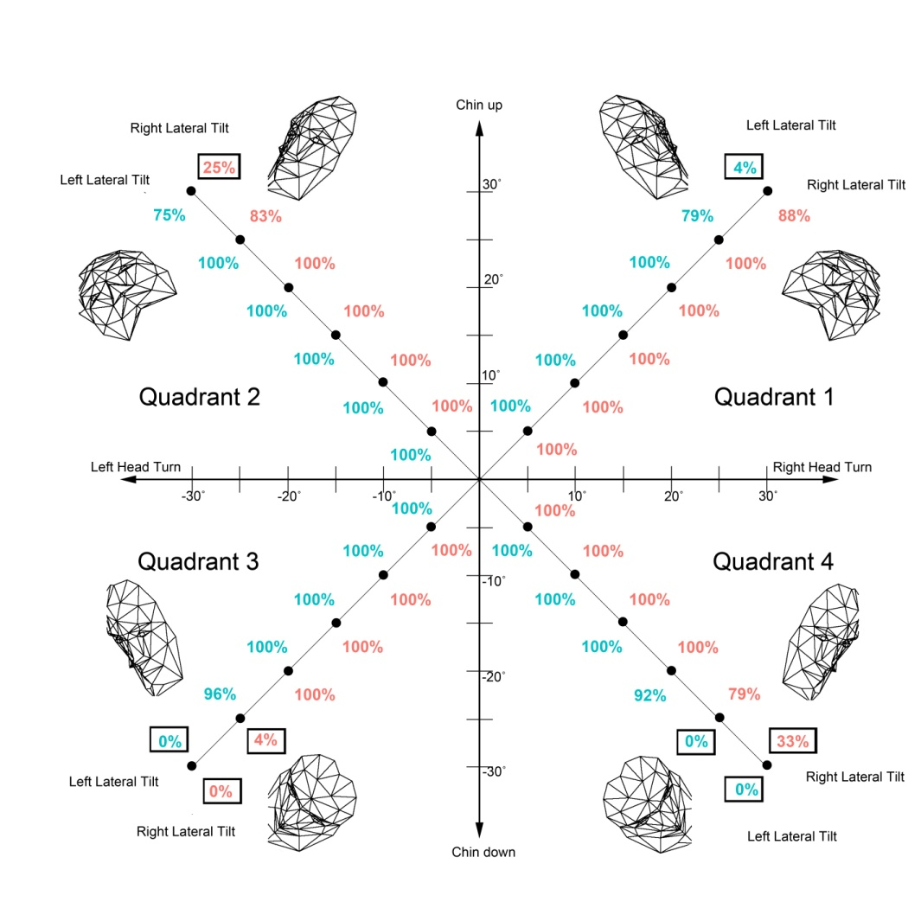
3-D : Face recognition rate

Slide 23
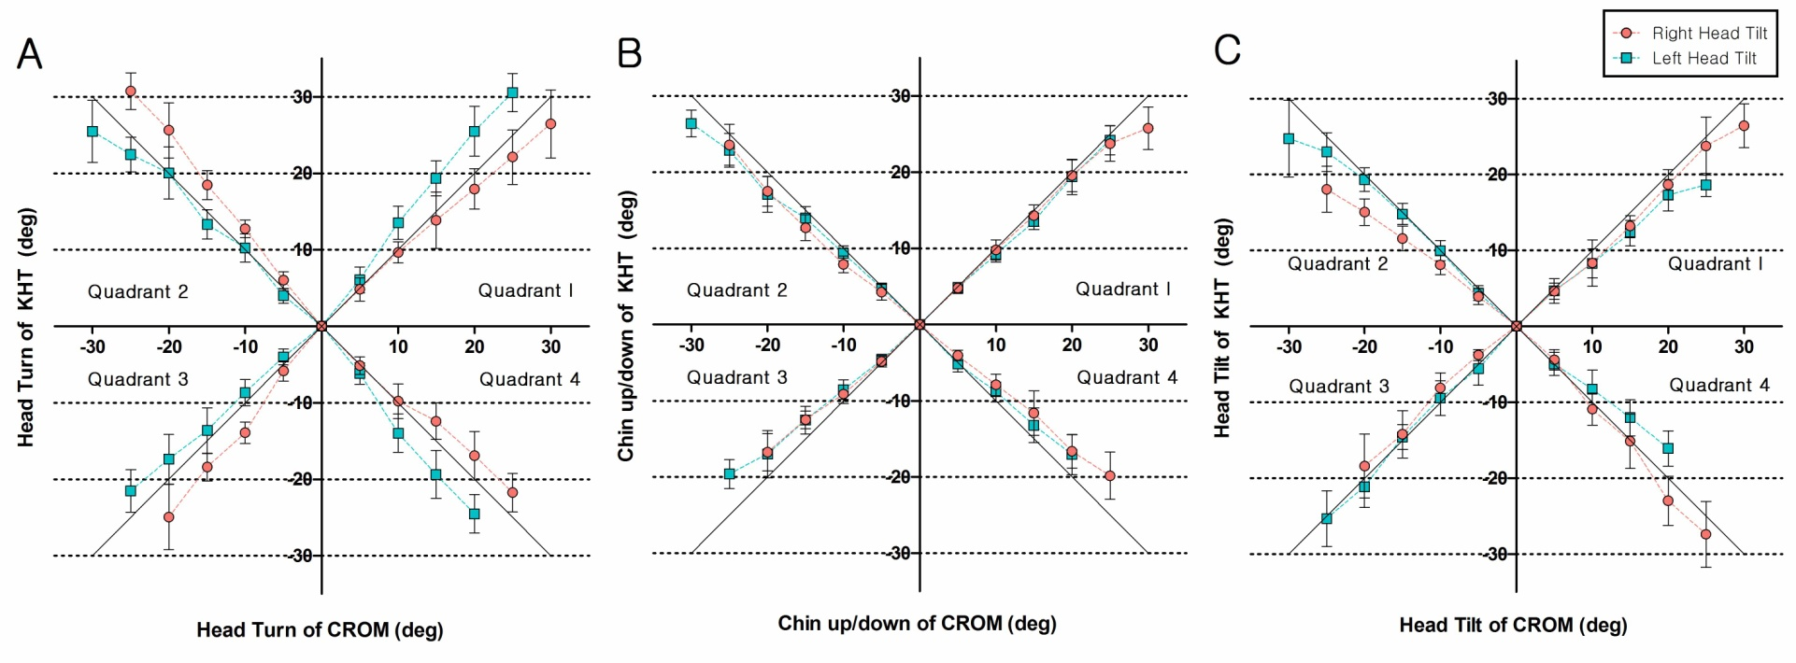
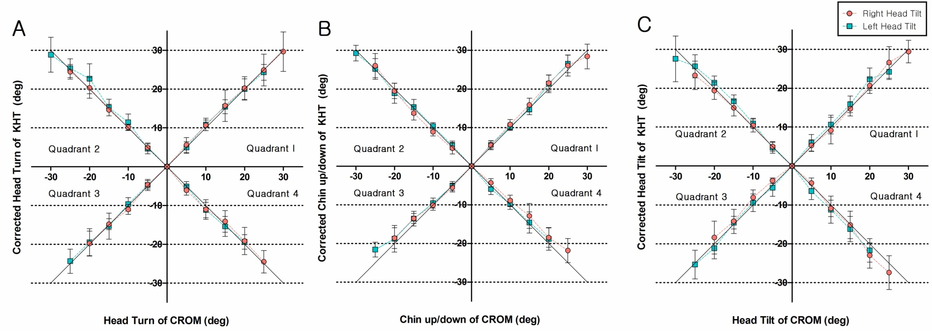
3- D : Validity

Slide 24
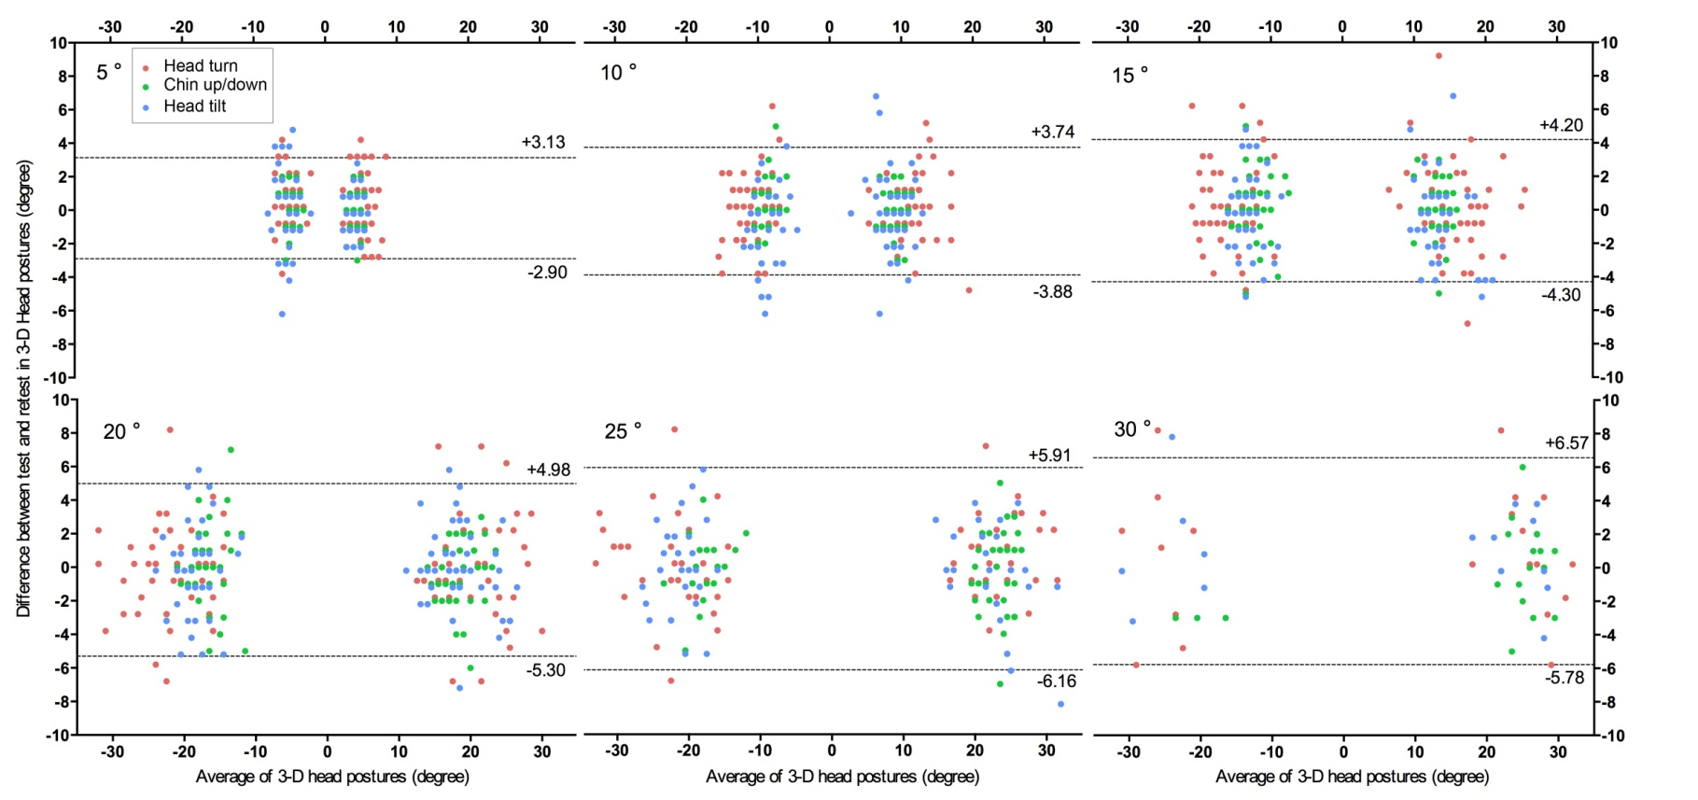
3 –D : Reliability (test-retest)
Bland-Altman plot

Slide 25
Our Results
 | 1-D (Head turn, Chin up/down, Head tilt) | 3-D (Head turn & Chin up/down & Head tilt)
Validity (Correlation, ICC) | Good | Fairly good -> Correctable
Reliability (Bland-Altman) | Good | Fairly good -> Comparable to previous studies
 |  | 단, 20도가 넘어가면 인식율이 떨어지기 시작함.

Slide 26
Discussion
Limitation
- the restricted range of head motion
using several Kinect for this limitation
Young children
- different facial configuration
Further study : KHT with patient

