Slide 1
Predicting Post-Operative Patient Gait
Jongmin Kim
Movement Research Lab.
Seoul National University

Slide 2
Pose predictor
Learn a pose predictor from training data set .
- : pre-operative patient’ pose (input)
- : post-operative patient’ pose (output)
Given new input data, we generate a new pose using the learned predictor.
New input data, x
Motion
database
Regression
process
Predictor
Output
pose

Slide 3
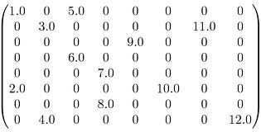
L1 regularization
Regularization based on the L1 drives
maximizes sparseness.
A new predicting post-operative gait can be estimated as matrix-vector multiplication.
- e.g.
L1 sparsity term

Slide 4
The problems
Correspondence
Can not explain the nonlinear relationship between training input and output.
Pre-operative
patient’s motion
Post-operative
patient’s motion

Slide 5
Mapping model
Motion to motion
- handling correspondence between remote poses
in temporal space
Find the method that fully explains the nonlinear relationship between training input and output.
- Nonlinear statistical regression methods

Slide 6
Related work
Predicting outcomes of rectus femoris transfer surgery [Reinbolt et al. 2009]
Long term outcome of single event multilevel surgery in spastic diplegia with flexed knee gait [Sung et al. 2012]

Slide 7
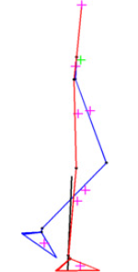
Design features
Kinematic features [Sung et al. 2012]
- mean pelvic tilt
- minimum hip flexion
- …
Middle swing left
- knee flexion
- left hip flexion
- ankle plantarflexion
right leg
left leg

Slide 8
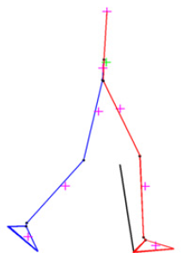
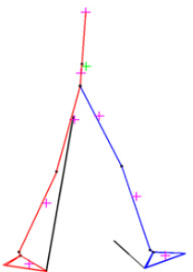
Design features
Left toe-off
- knee flexion (velocity)
- ankle plantarflexion (velocity)
- right hip flexion
- pelvis forward velocity
Terminal swing left
- knee flexion
- ankle plantarflexion
- left hip internal rotation
left leg
right leg
right leg
left leg

Slide 9
Future work
Design training input & output with respect to the clinical context. (very important !)
- GCD data
Motion to motion
Nonlinear statistical regression models
- SVR, Gaussian process, …

