Slide 1
3D Musculoskeletal Model
이승환

Slide 2
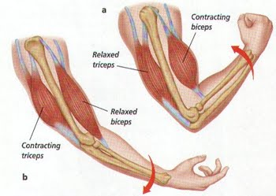
Muscle Model

Slide 3
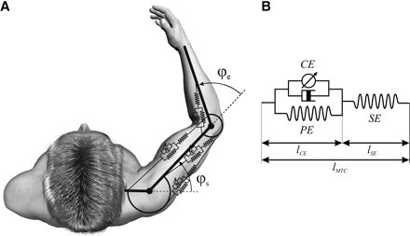
Line segment muscle

Slide 4
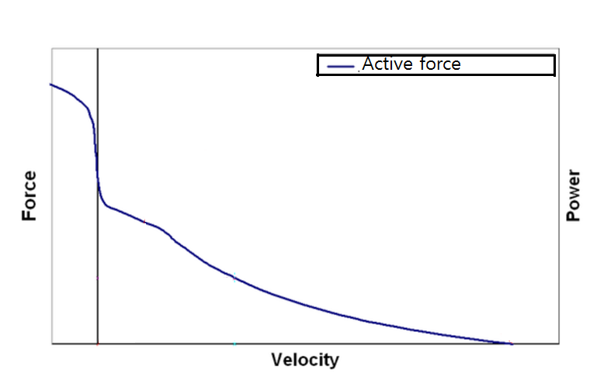
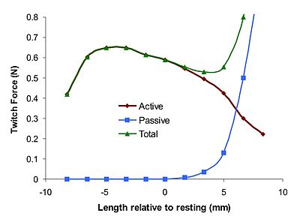
Force-Length-Velocity Relation

Slide 5
Muscle Simulation
$$t_{n}$$
$\vec{p_{n}}$
$$a,l,\dot{l}$$
$$\vec{F_{n}}$$
$\vec{p_{n+1}}$

Slide 6
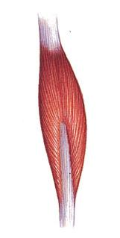
Return to Volumetric model
No information about Volumetric muscle.
-> Using line-segment muscle data.
How?

