Slide 1
Surgery simulation

Slide 2
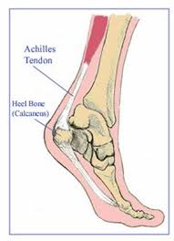
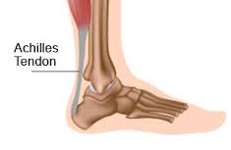
tendo achilles lengthening

Slide 4
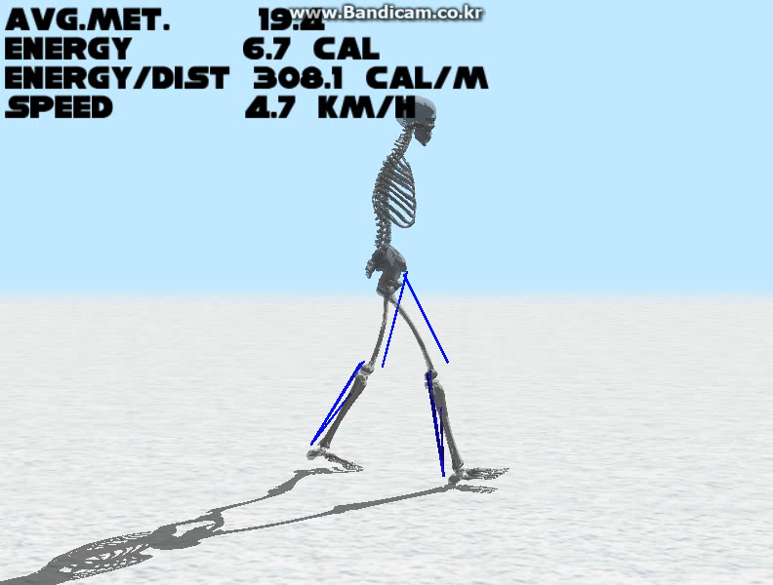

Slide 5
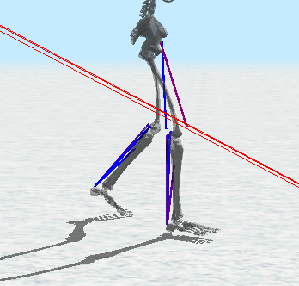
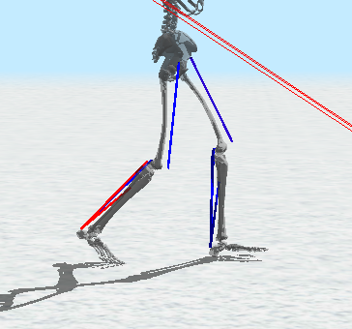
Original tendon length
Tendon length – 2.5cm

Slide 6
Trajectory optimization
CMA
18 dimension
  3 pose * (swing foot + support foot) * (xyz coordinate)

Slide 7
Swing foot
Support foot
offset
offset

Slide 8
Swing foot
Support foot
angle
angle

Slide 9
Trajectory optimization
CMA
24 dimension
  3 step * (swing foot + support foot)
  *(xyz coordinate + ankle angle)

